Slide 1
AE222-MPM Task-1
Done by:
G.RAMANA BHARATHI
SC19B028

Slide 2
Objectives & Constraints
Objectives
Constraints
Design a housing to accommodate the three sensors and the PCB board described.
Identify machining operations and their sequence to manufacture the housing.
Identify machining tools and cutting tools for performing the operations.
Identify measuring methods and instruments to verify the tolerances/dimensions given in the design.
Overall size of housing:200±5 x 200±5 x 100±5 mm
Preferable weight of housing < 3Kg
Raw material given: Metal blanks of size 250 x 250 x 60 mm – 2nos
Surfaces marked ‘TOP’ on the sensors should be exposed out of the housing.
D-Pin connectors of the PCB board should be exposed out of the housing.
A gap of 10 mm should exist above and below the PCB board.

Slide 3
Assumptions
Sensor-1 and sensor-2 can be wired from underneath.
In addition to the given raw material, we assume a cylindrical rod of radius 60mm and height 60 mm to be given.
All kinds of machine tools and cutting tools are available.
Mass of PCB board is assumed to be 50 g.

Slide 4
General Procedure
All machining operations are done using CNC machining.
Lathe operations are performed in CNC Lathe.
Milling operations are performed in CNC column-and-knee (vertical-spindle) milling machine.
Drilling operations are performed in CNC drilling machines.
Metrology is performed on a surface table.
General Dimensioning and tolerance standard used in every drawing: ISO 2768 – m K

Slide 5
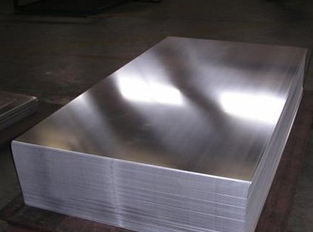
Raw material selection
Aluminium 6061 T6
high strength to weight ratio
Density-2.72 gcc
Fairly Machinable: machinability grade ‘C’
Corrosion resistance
Source: Indiamart

Slide 6
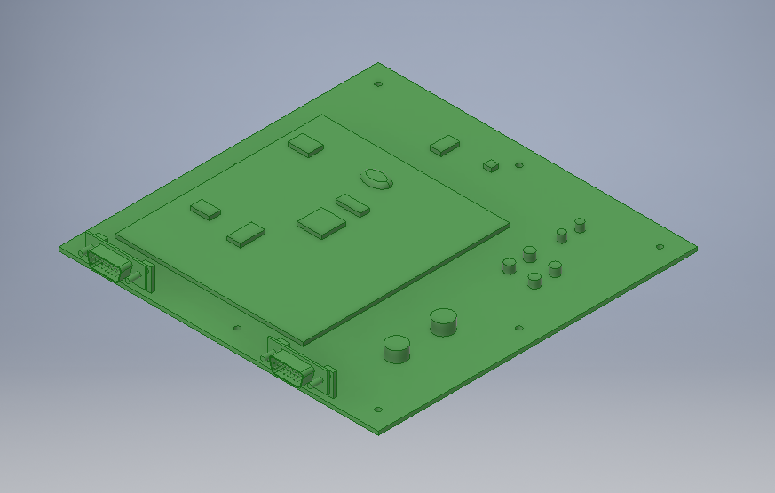
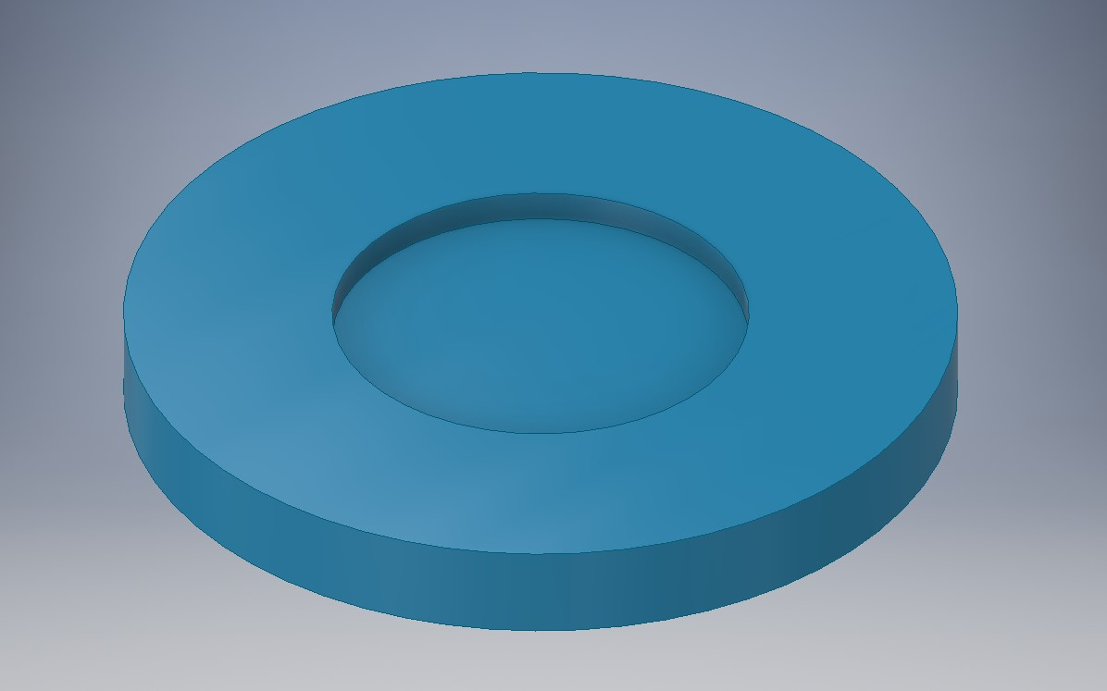
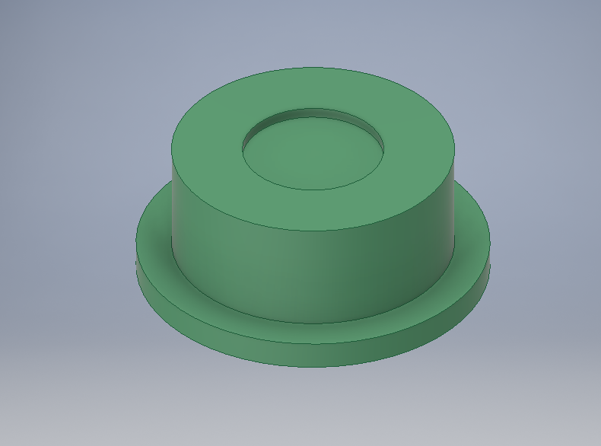
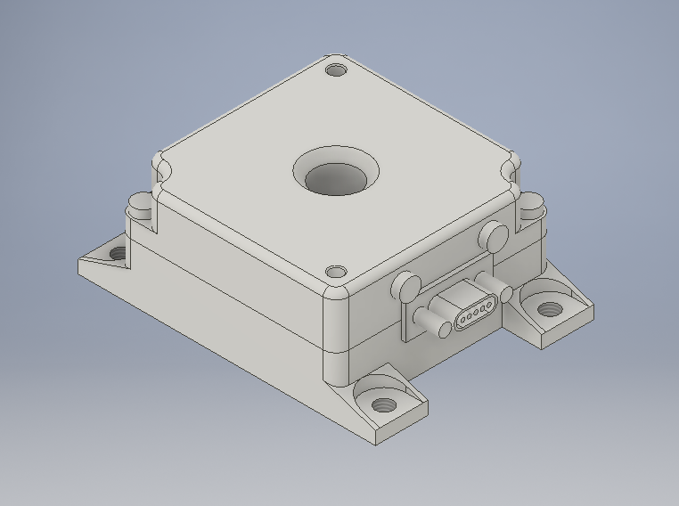
Sensors And PCb
PCB
Sensor-1
Sensor-2
Sensor-3

Slide 7
General machining sequence
Since we require different starting blocks from the given material, we prepare them beforehand.
For the housing, we take the two 250x250x60 mm blocks and cut into desired pieces using metal saw to produce:
200x200x56 mm blank for top part
200x200x50 mm blank for bottom part
For the lid of the housing, we use a metal sheet of dimension 200x200 mm and thickness 3 mm
For the locks of two of the sensors, we take the cylindrical rod and cut into two pieces using grooving tool in lathe (parting off) to produce:
Cylindrical block of radius 60 mm and height 40 mm which is later turned across the length to produce a cylindrical blank of radius 55 mm and height 40mm for lock of sensor-1
Cylindrical blank of radius 60 mm and height 11 mm for lock of sensor-2.
For the lock of third sensor, we use the remains of the given square blocks to produce two blanks of dimensions 68x12x15 mm.
All the blanks have their surfaces finished using surface grinding.

Slide 8
Housing: bottom part - design features
Open structure (box type)
Threaded holes for attaching the spacers on which the PCB board will be mounted.
Square through holes on the side for exposing the two D-Pin connectors on the board.
Threaded through holes near the top of the side walls to attach with the top part.

Slide 9
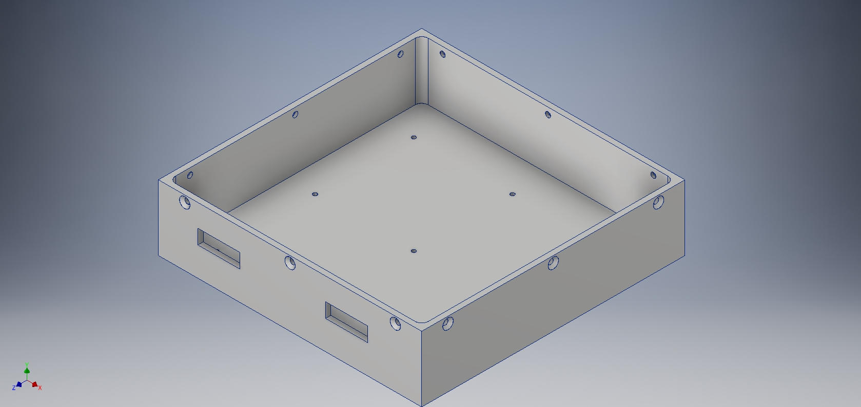
Housing: bottom part - image

Slide 10
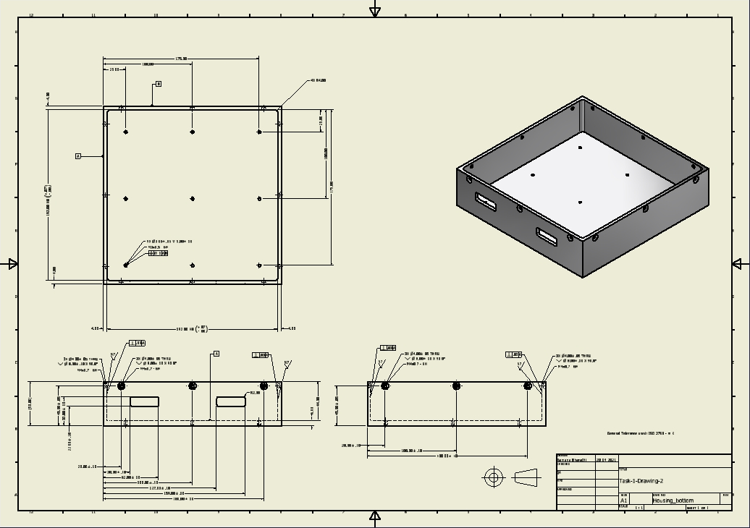
Housing: Bottom part - drawing

Slide 11
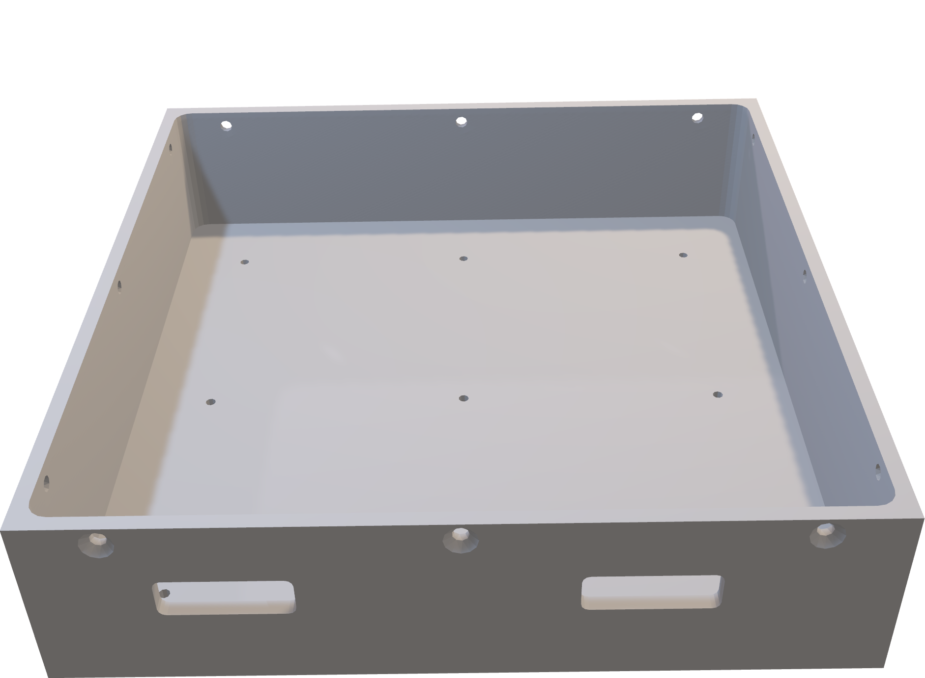
Housing: bottom part – 3D

Slide 12
Housing: bottom part - machining sequence
We start with 200x200x50 mm blank.
The square pocket is made using drilling and circular milling. A hole is drilled at the centre using the drilling machine and enlarged (bored) enough to fit the shoulder end mill cutter. Then the shoulder end mill cutter is fitted into the hole and driven in circle and eventually squares to make the square pocket. Another technique that can be used is circular ramping (shoulder end mill cutter goes around in spiral from top to down-drilling not required).
The two square through holes at the side are made using drilling and circular milling/circular ramping. Since the holes are too small, Wire EDM is preferable if available.
The 9 holes on the base are drilled using drilling machine (drilling machine, 3mm drill bit) and threaded using tapping (drilling machine, tap).
The 12 holes on the upper side of the walls are drilled (drilling machine, 4mm drill bit) and countersunk (drilling machine, countersink drill bit) and threaded using tapping (drilling machine, tap)
Inner walls are finished using reaming (drilling machine, reamer)
All the holes are deburred and surfaces are cleaned. The bottom part is completed.

Slide 13

Housing: bottom part - machining sequence

Slide 14
Housing: bottom part - metrology
Linear dimensions are measured using vernier callipers.
Length, width, height of the part
depth of the pocket
Length, width and location of square holes
Diameter of threaded holes are measured using inside micrometer. Depth of threaded holes can be measured using depth micrometer.
Position tolerance of the holes is measured using Co-ordinate measuring machine (CMM).
Perpendicularity of surfaces is measured using height gauge and dial indicator.

Slide 15
Housing: Top part - Design features
Open structure (box type)
Threaded holes on the base for attaching locks of sensor-2 and sensor-3.
Wiring allowance: Through holes on the base for each sensor and a common through hole so that wires can connect the sensors in the top part to the board in the bottom part.
(Note that it is been assumed that sensor-1 and sensor-2 can be wired from underneath but they can be wired through the common hole if that’s not possible)
Protrusion with threaded holes at the bottom face to mate(snug fit) and attach with the bottom part and threaded holes in the top corners of the box to attach with the lid.

Slide 16
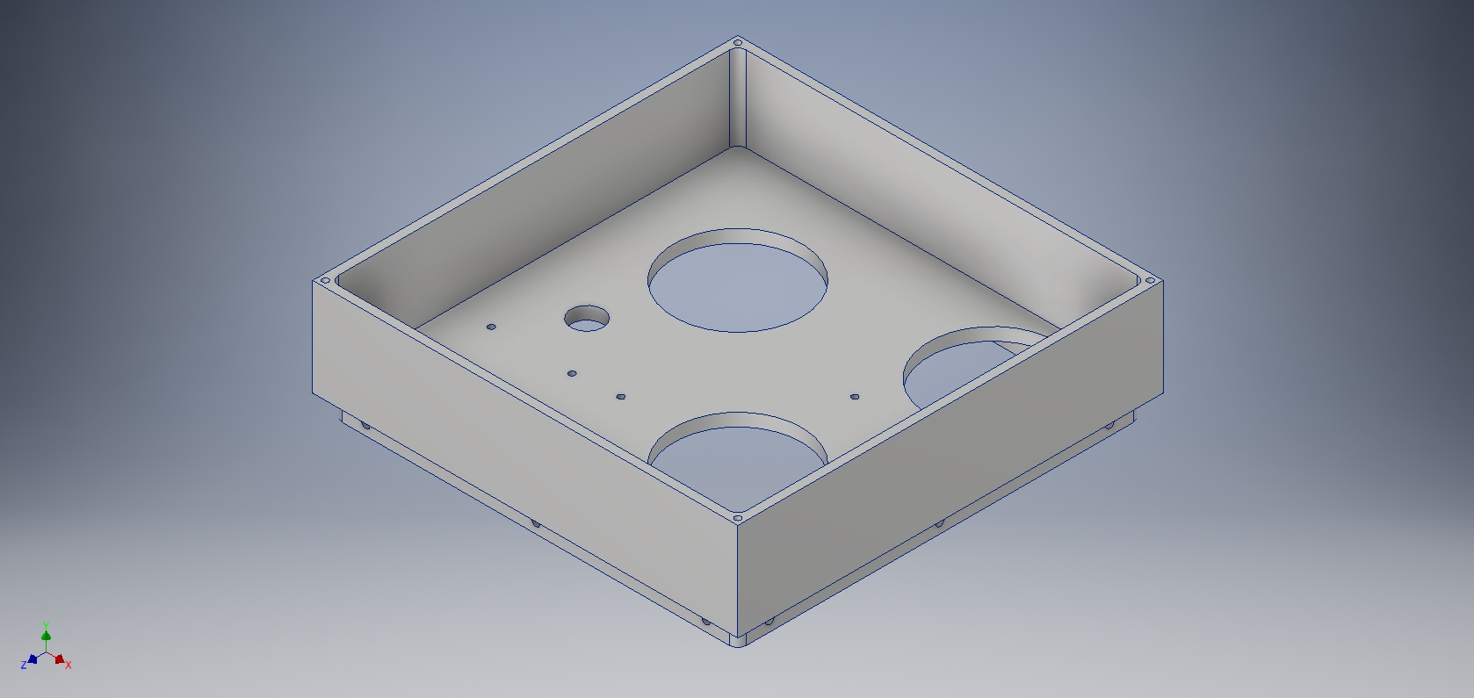
Housing: Top part - Image

Slide 17
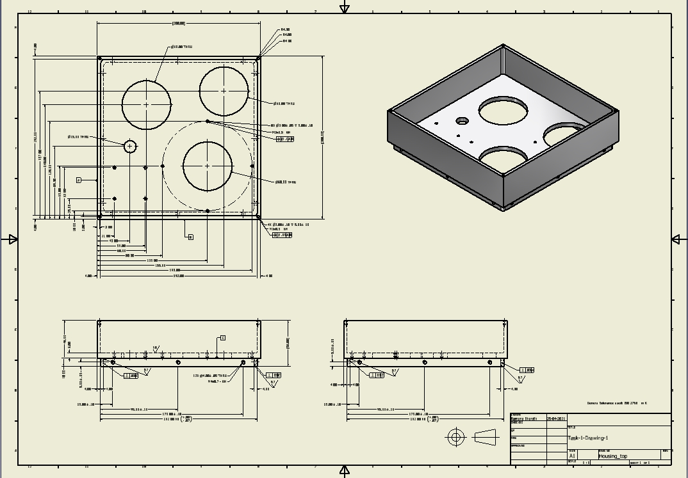
Housing: Top part - drawing

Slide 18
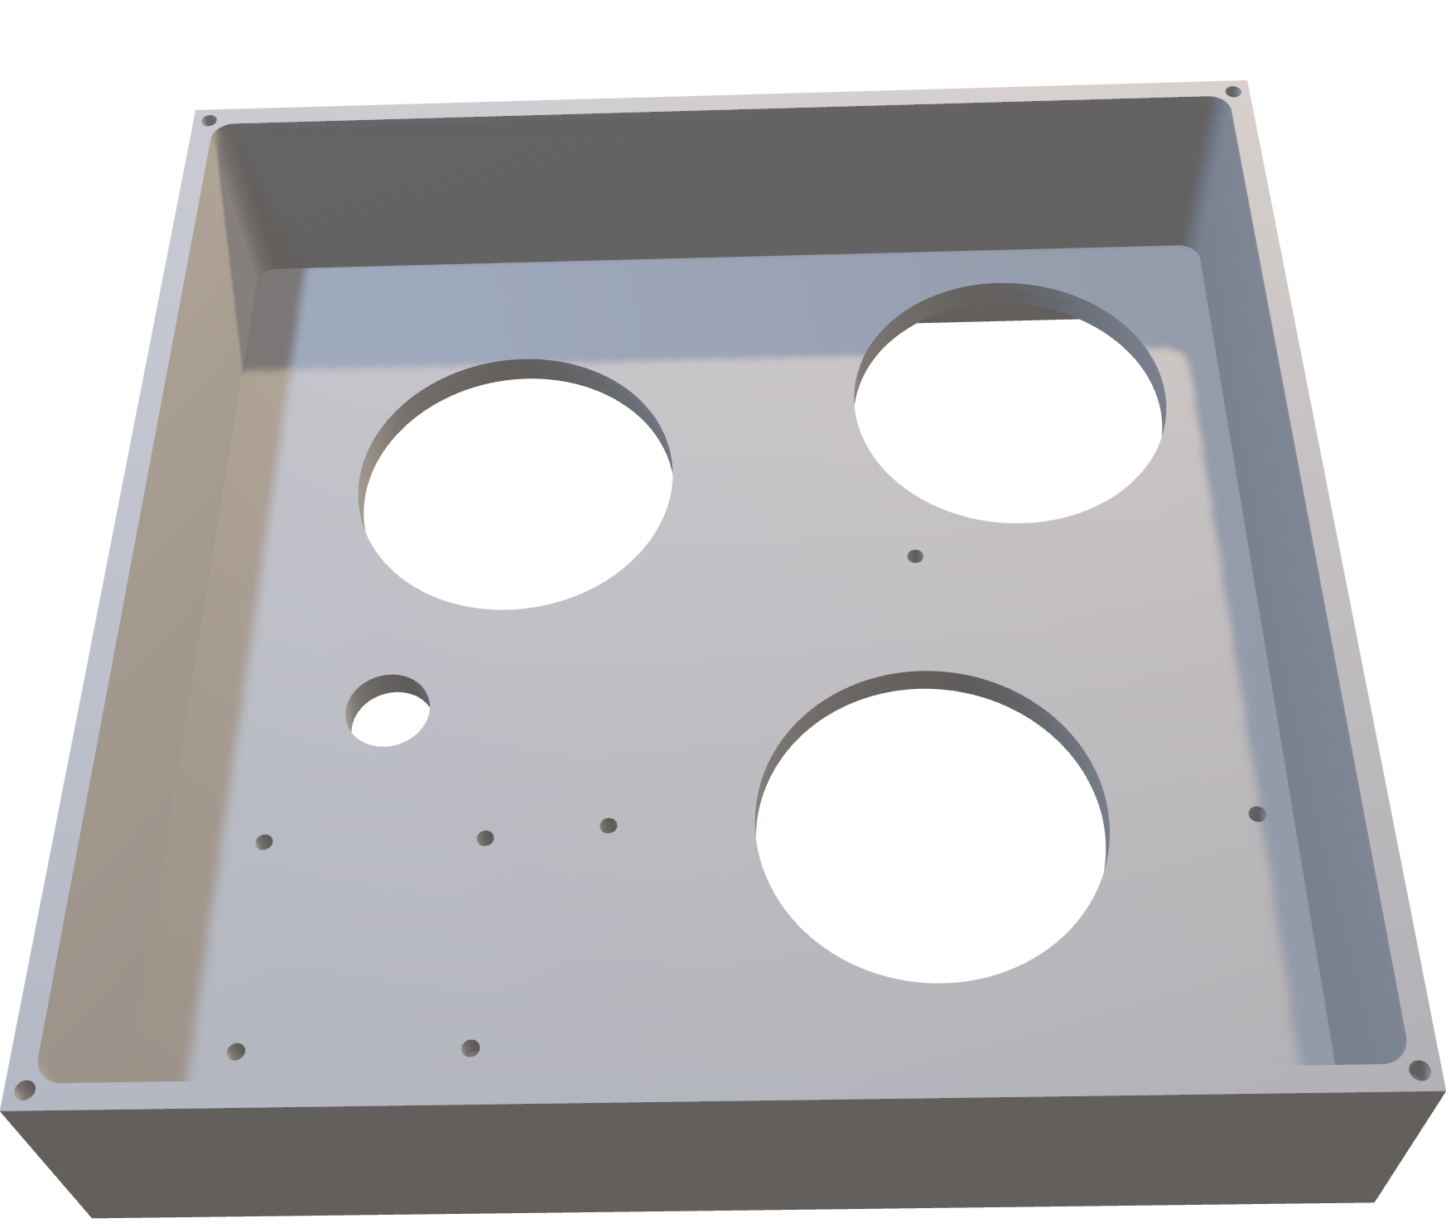
Housing: Top part – 3D

Slide 19
Housing: Top part – Machining Sequence
We start with the 200x200x56 mm blank.
The square pocket is made using drilling and circular milling/circular ramping (described in machining sequence of bottom part of housing)
Underneath extension is made by using drilling and circular milling (drilling machine, drill bit, milling machine, shoulder end mill cutter) in the centre and shoulder milling (milling machine, square shoulder cutter/end mill cutter) on the periphery.
The larger wiring holes are made using trepanning (drilling machine, trepanning tool) and the small hole is drilled (drilling machine, 15 mm drill bit).
The sensor mounting holes on the base are drilled (drilling machine, 3 mm drill bit) and threaded using tapping (drilling machine, tap)
The 4 holes on the 4 corners of the walls are drilled (drilling machine, 3 mm drill bit) and threaded using tapping (drilling machine, tap)
12 Holes are drilled (drilling machine, 4mm drill bit) on the extension and threaded using tapping (drilling machine, tap)
All the holes are deburred and surfaces are cleaned. The top part is completed.

Slide 20

Housing: Top part – Machining sequence

Slide 21
Housing: Top part - metrology
Linear dimensions are measured using vernier callipers.
Length, width, height of the part
depth of the pocket
Diameter of the large holes are measured using bore gauge.
Diameter of threaded holes are measured using inside micrometer. Depth of threaded holes can be measured using depth micrometer.
Position tolerance of the threaded holes is measured using Co-ordinate measuring machine (CMM).
Perpendicularity of surfaces underneath is measured using height gauge and dial indicator.

Slide 22
Housing: lid - design features
Square metal sheet
Through holes for exposing the three sensors
Threaded holes at the four corners to attach to the top part.

Slide 23
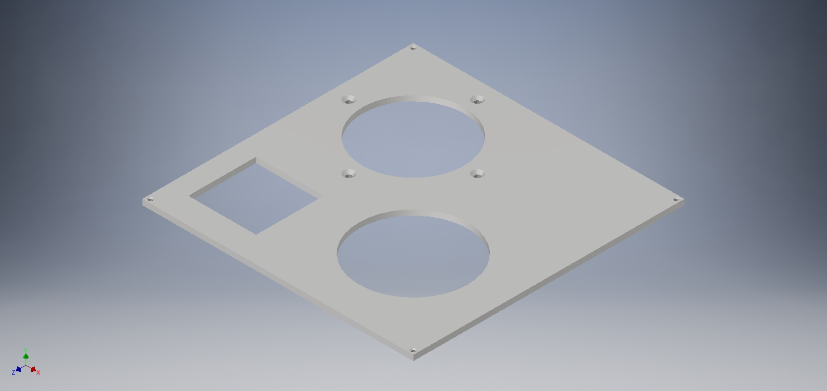
Housing: Lid- image

Slide 24
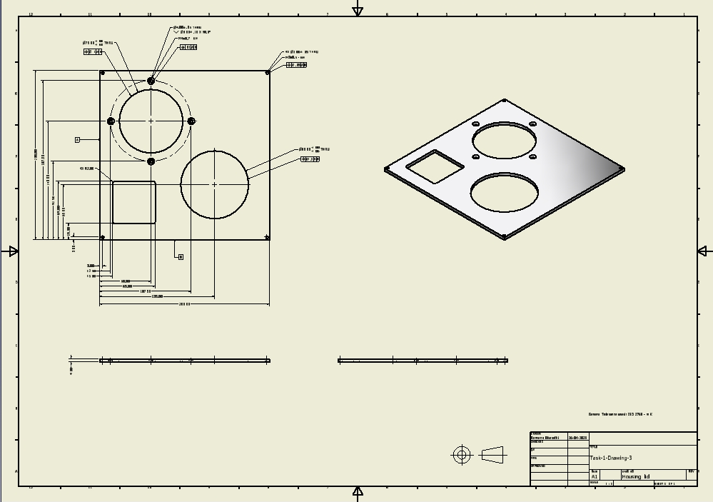
Housing: lid- drawing

Slide 25
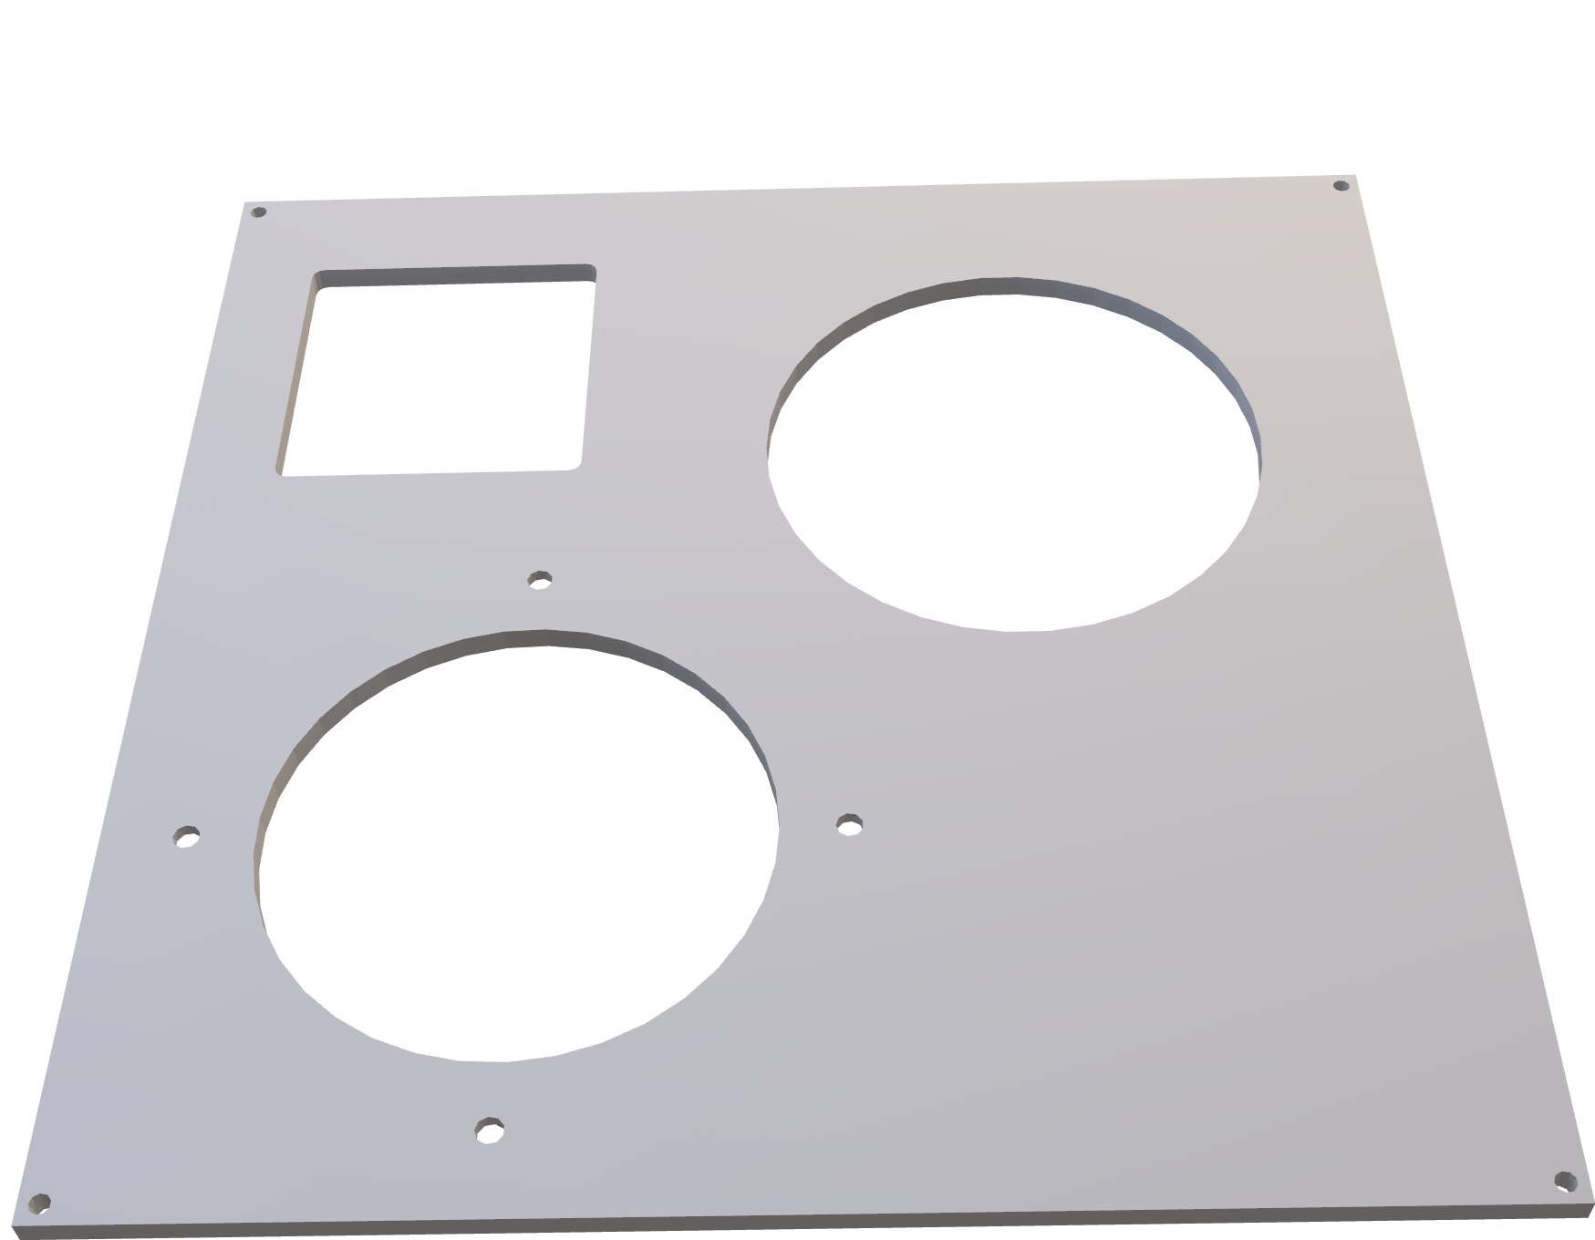
Housing: lid – 3D

Slide 26
Housing: lid- machining sequence
We start with 200x200x3 mm metal sheet.
The two circular holes are made using trepanning (drilling machine, trepanning tool) and the square hole is made using circular ramping. (milling machine, shoulder milling cutter)
The 4 holes for attaching lock for sensor-1 are drilled (drilling machine, 4 mm drill bit), countersunk (drilling machine, countersink drill bit)and threaded using tapping (drilling machine, tap)
The 4 holes at the corners are drilled (3 mm drill bit) and threaded using tapping.
All the holes are deburred and surfaces are cleaned. The lid is completed.

Slide 27

Housing: lid- machining sequence

Slide 28
Housing: lid- metrology
Linear dimensions are measured using vernier callipers.
Length, width, height of the part
depth of the pocket
Length, width and location of square hole
Diameter of holes are measured using bore gauges
Diameter of threaded holes are measured using inside micrometer.
Position tolerance of the circular holes are verified using Co-ordinate measuring machine (CMM).

Slide 29
Accessories for assembly
Spacers (male-to-male, M3 bolts, spacing width:10 mm) for mounting the PCB board (X9)
Locks for each sensor so that the sensors can latched on
Fasteners:
AS 1427 M3 X 8 (X8) [rounded screws]
AS 1427 M3 X 16 (X4) [countersunk screws]
AS 1427 M4 X 6 (X4) [countersunk screws]
AS 1427 M4 X 8 (X16) [countersunk screws]
AS 1112 – M3 TYPE 5 (X8) [nuts]
The spacers and the fasteners can be bought COTS, but the locks have to be custom made.

Slide 30
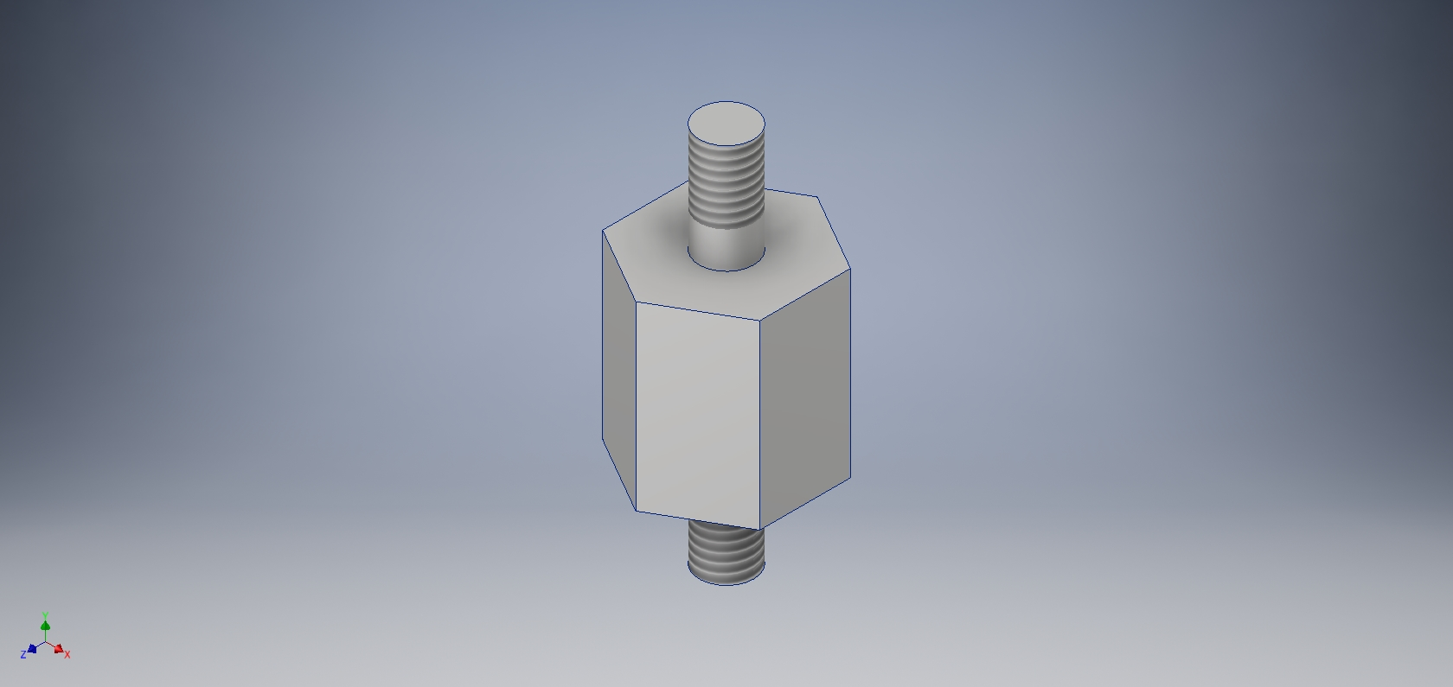
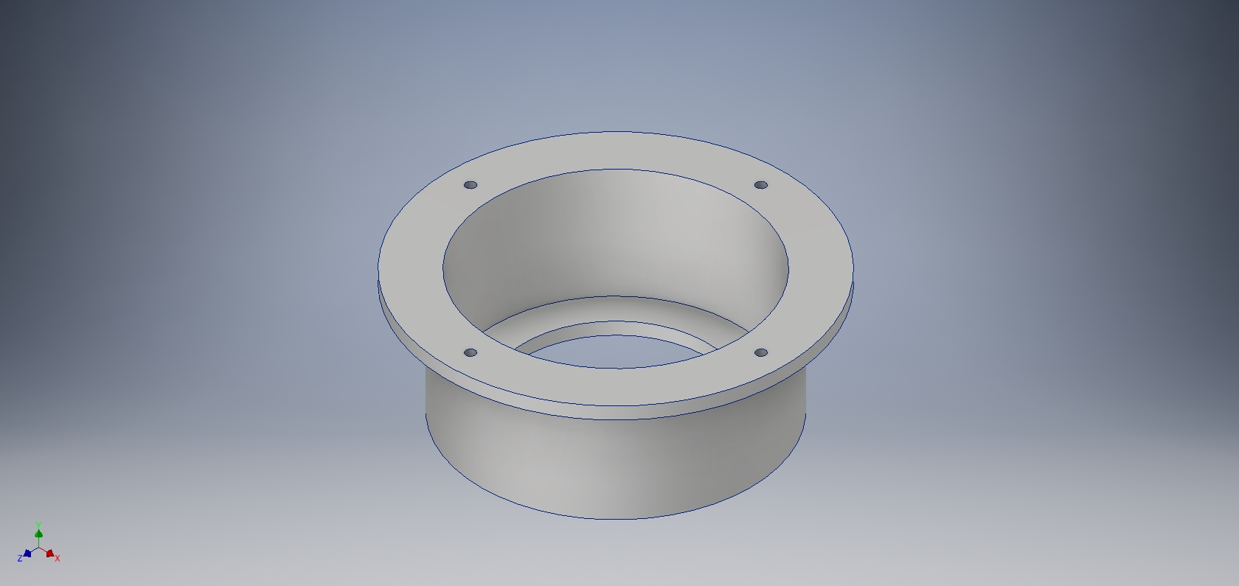
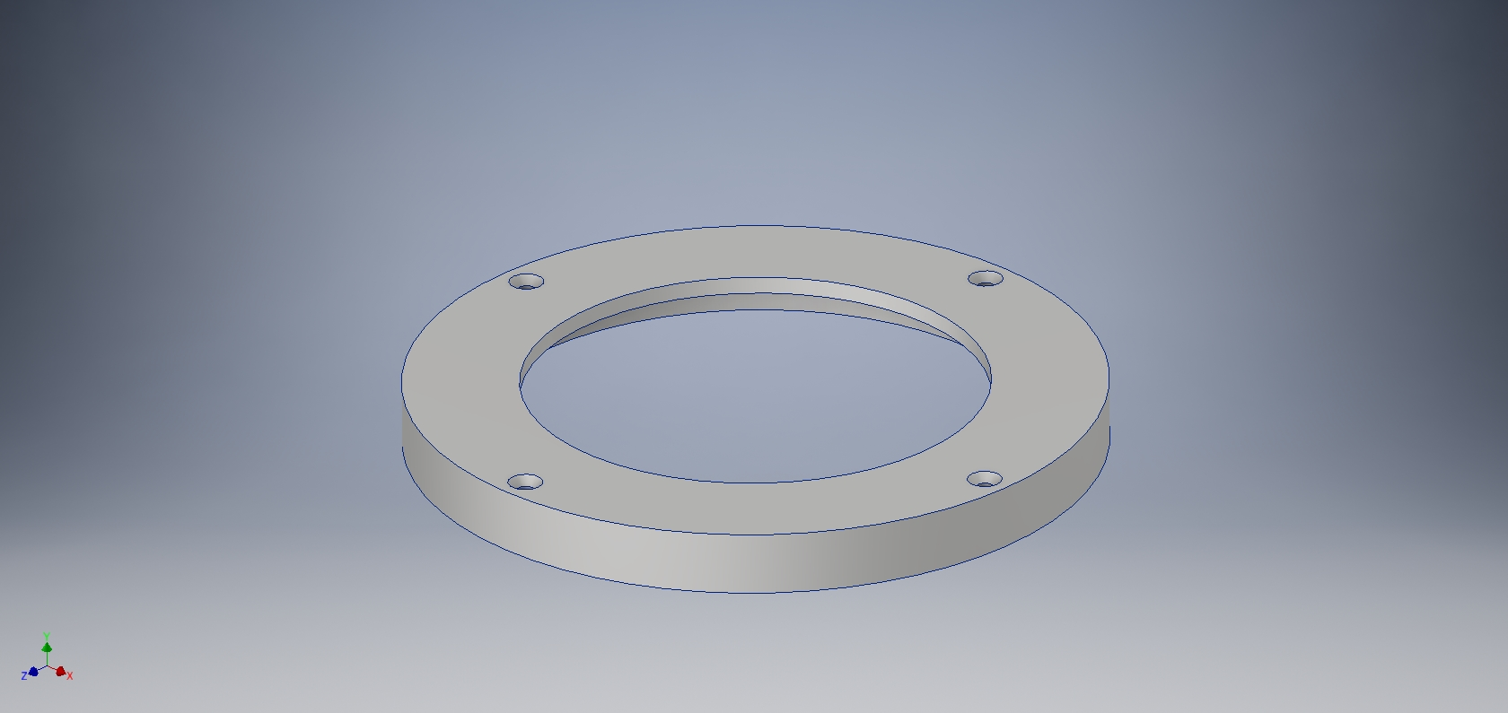
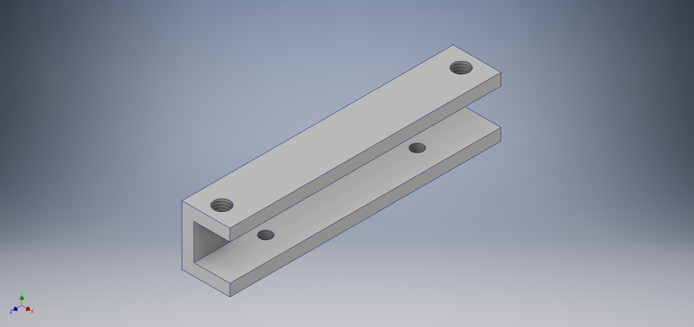
Locks and spacers
Sensor-1 Lock
spacer
Sensor-2 lock
Sensor-3 lock

Slide 31
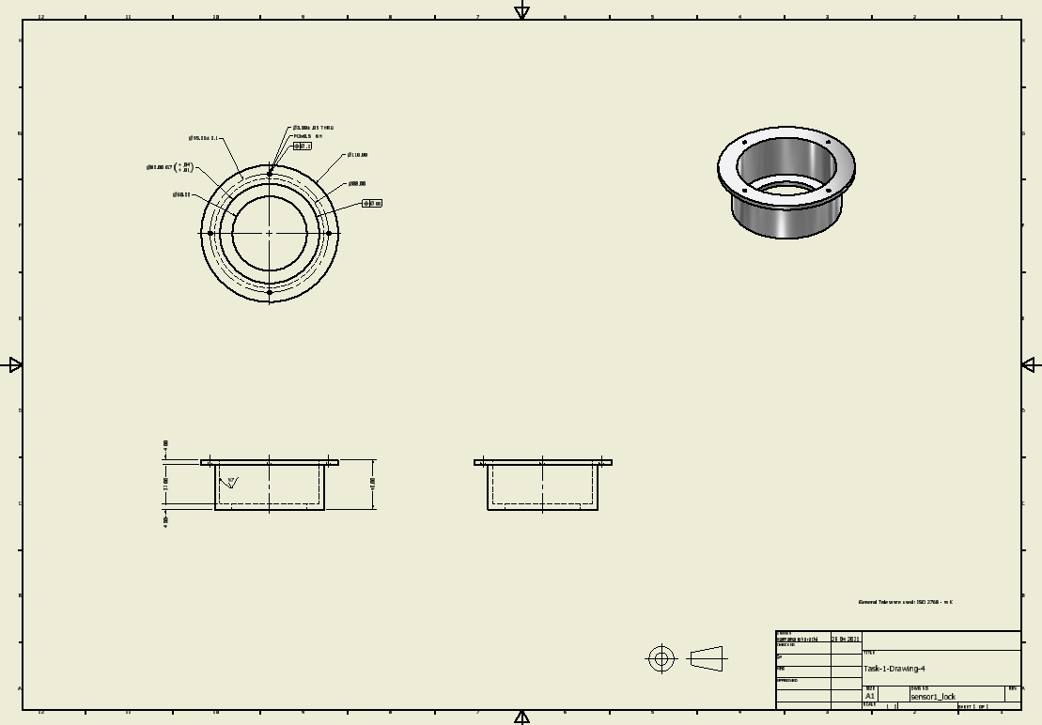
Lock for Sensor-1 - drawing

Slide 32
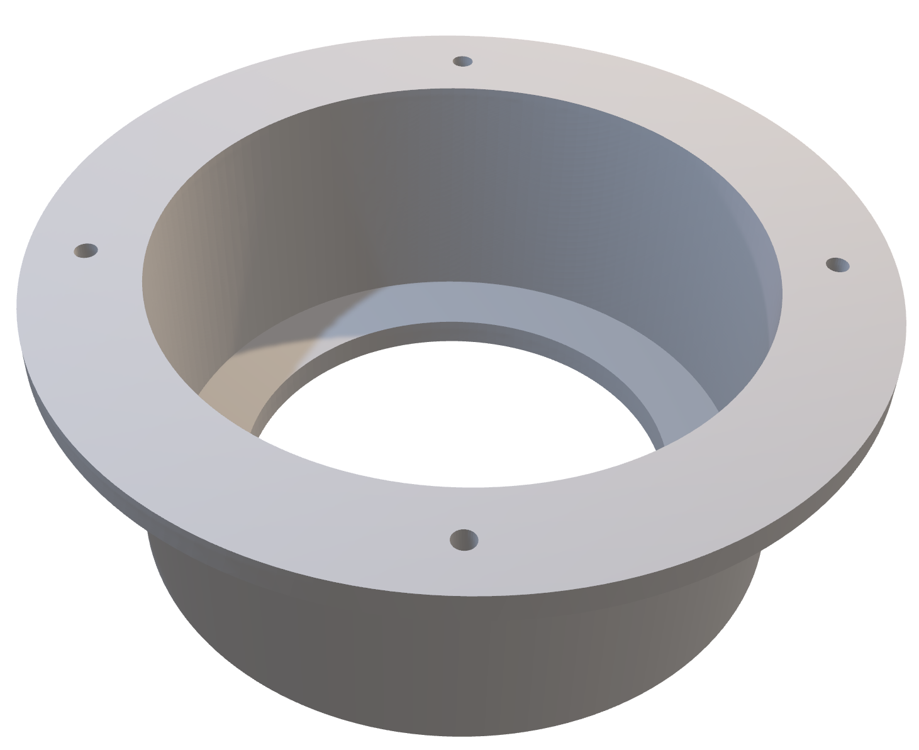
Lock for Sensor-1 - 3D

Slide 33
Lock for Sensor-1 - Machining sequence
We start with the cylindrical blank of radius 55 mm and height 40 mm.
The blank is turned (lathe, single-point cutting tool) from below to make the cylindrical T feature.
A through hole is drilled and bored (lathe, drill bit, boring tool) at the centre.
The hole is still bored (lathe, boring tool) leaving a step to create vacant space to accommodate the sensor and then finished using reaming (lathe, reamer)
The 4 holes on the periphery are drilled (drilling machine, 4mm drill bit) and threaded using tapping (drilling machine, tap)
All the holes are deburred and surfaces are cleaned. The lock for sensor-1 is completed.

Slide 34

Lock for Sensor-1 - Machining sequence

Slide 35
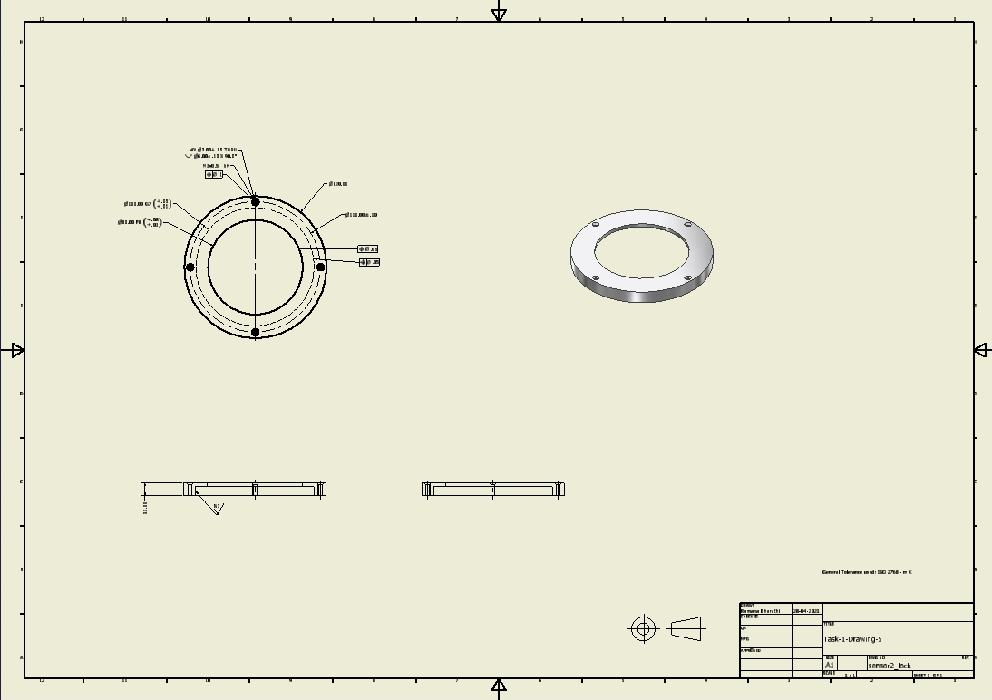
Lock for Sensor-2 - drawing

Slide 36
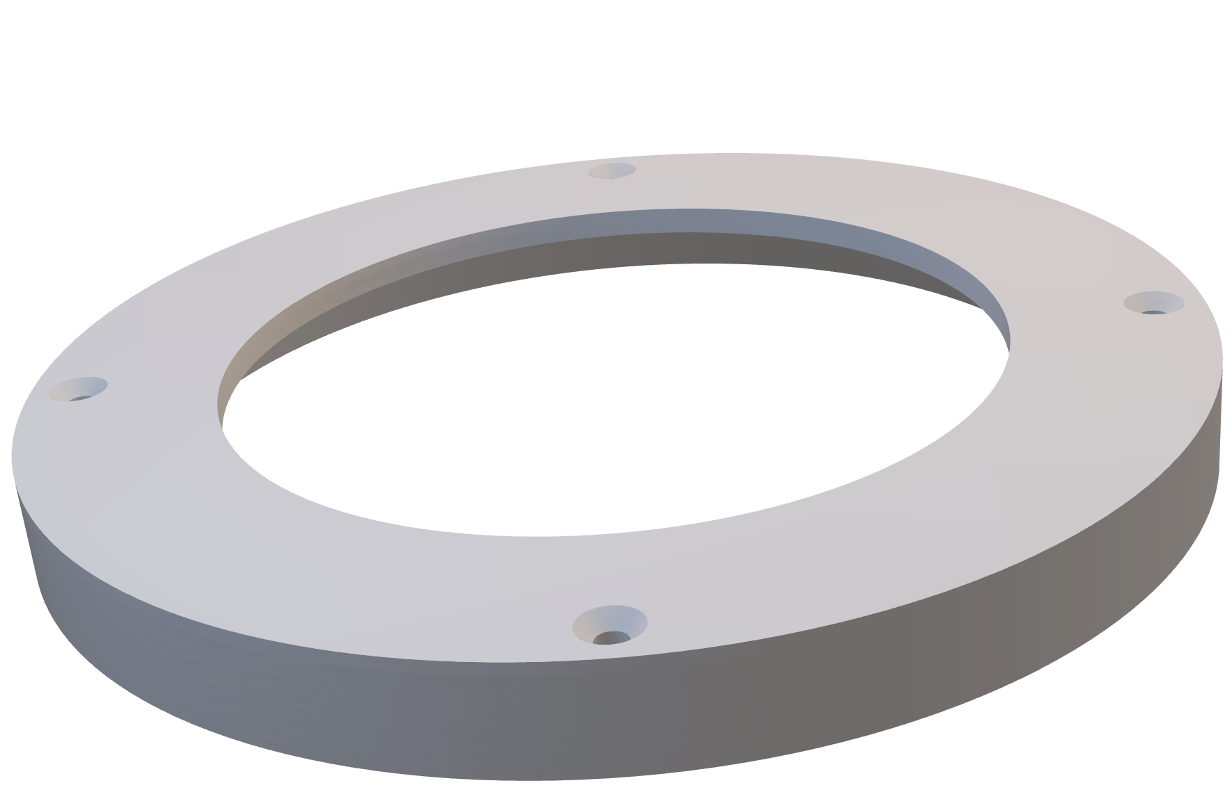
Lock for Sensor-2 - 3D

Slide 37
Lock for Sensor-2 - Machining sequence
We start with the cylindrical blank of radius 60 mm and height 11 mm.
The through hole is drilled and bored (lathe, drill bit, boring tool)
It is turned upside down and bored(lathe, boring tool) to produce the circular step.
The hole surfaces are finished using reaming. (lathe, reamer)
The 4 holes on the periphery are drilled (drilling machine, 3mm drill bit) and threaded using tapping (drilling machine, tap)
All the holes are deburred and surfaces are cleaned. The lock for sensor-2 is completed.

Slide 38

Lock for Sensor-2 - Machining sequence

Slide 39
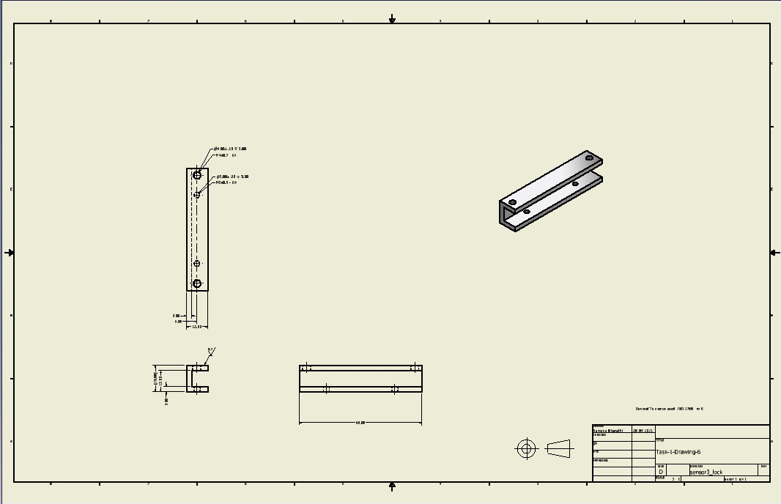
Lock for Sensor-3 - drawing

Slide 40
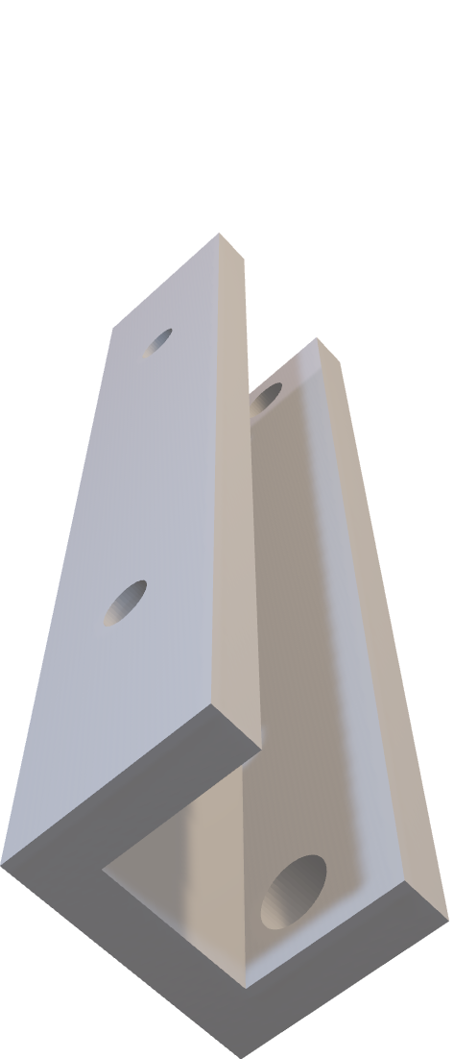
Lock for Sensor-3 – 3D

Slide 41
Lock for Sensor-3 - Machining sequence
We start with the 68x12x15 mm blank.
The side slot is made using slotting (milling machine, slotting cutter) or end milling (milling machine, end mill cutter)
The 4 holes on the top and bottom surfaces are drilled (drilling machine, 3mm and 4mm drill bits) countersunk (drilling machine, countersink drill bit) and threaded using tapping (drilling machine, tap)
Upper surface of the lock is finished using surface grinding.
All the holes are deburred and surfaces are cleaned. One lock for Sensor-3 is completed. Another one is done in the same way.

Slide 42

Lock for Sensor-3 - Machining sequence

Slide 43
Accessories for assembly - metrology
Linear dimensions are measured and sizes of the holes using vernier callipers.
Height, inner diameter, outer diameter, depth for first two locks.
Height, width, length, thickness in third lock
Diameter of holes are measured using inside micrometer.
Position tolerance of the holes is measured using Co-ordinate measuring machine (CMM).
Fits of the holes can be verified using pin gauges.

Slide 44
Assembly
For the bottom part,9 M3 spacers are fastened on its base and the PCB board is mounted on them such that the D-Pin connectors get exposed through the square holes and the PCB board is held in place using 8 M3 nuts over the spacers. (the PCB board can be minimally mounted using only 4 spacers on the corners)
For the top part, 2 locks for sensor-3 are attached on the base using two M3 screws each and sensor-3 is mounted on top using four screws. Sensor-2 is inserted into its lock (sliding fit) and the lock is attached to the base using 4 long M3 screws.
For the lid, the 4 discs of sensor-1 is placed into its lock one by one (sliding fit) and the lock is attached to the lid using 4 M4 screws.
All the wiring working is done and the top part is mounted (snug fitted) on the bottom part and attached using 12 M4 screws (3 a side) and lid is mounted on the top part and is attached using 4 M3 screws on the corners.

Slide 45
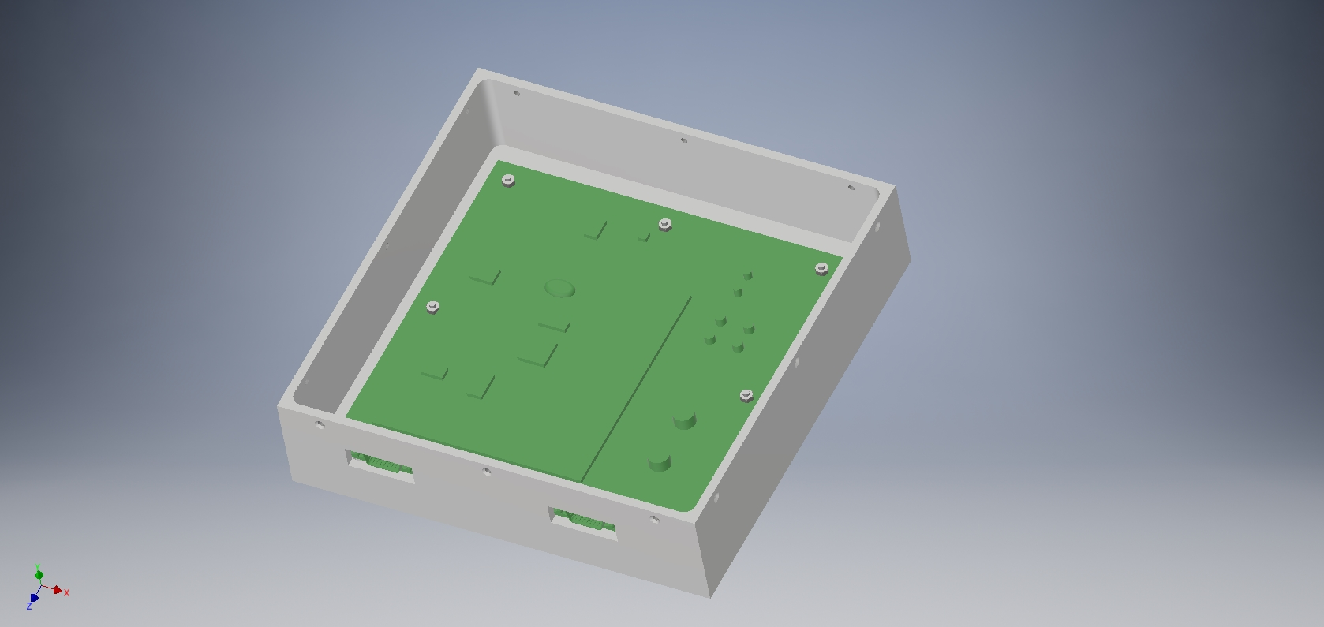
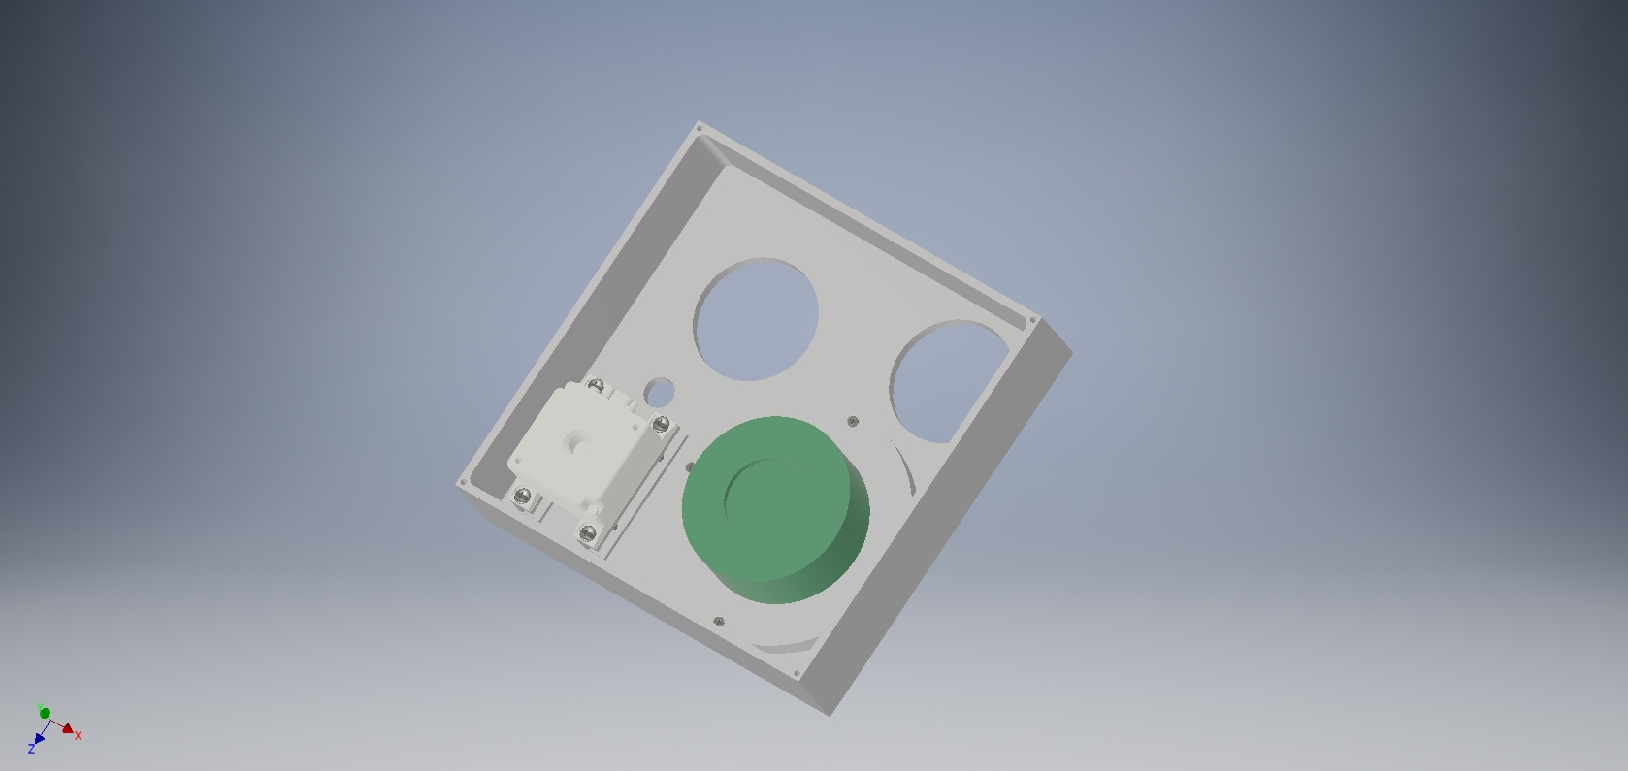
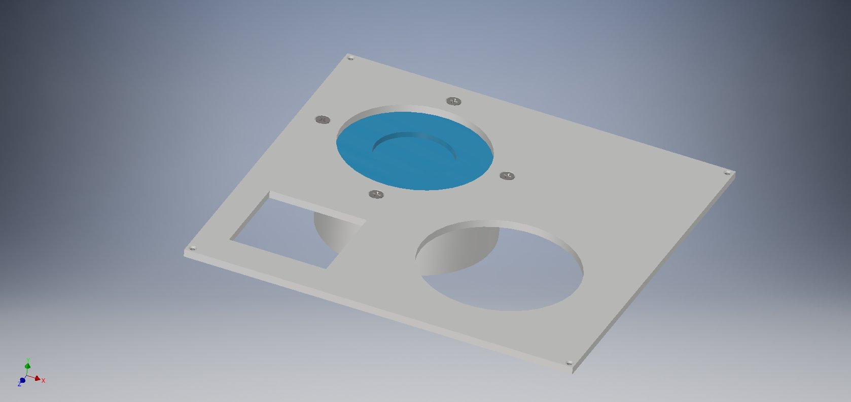
Housing: Bottom part assembled
Housing: Top part assembled
Housing: lid assembled

Slide 46
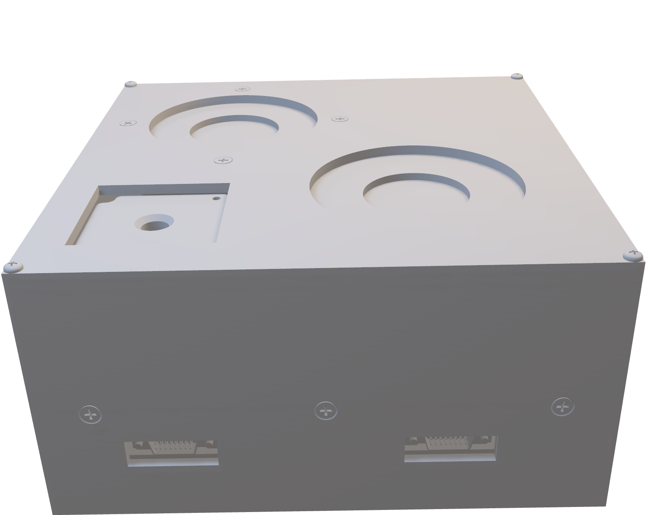
Assembly – 3D

Slide 47
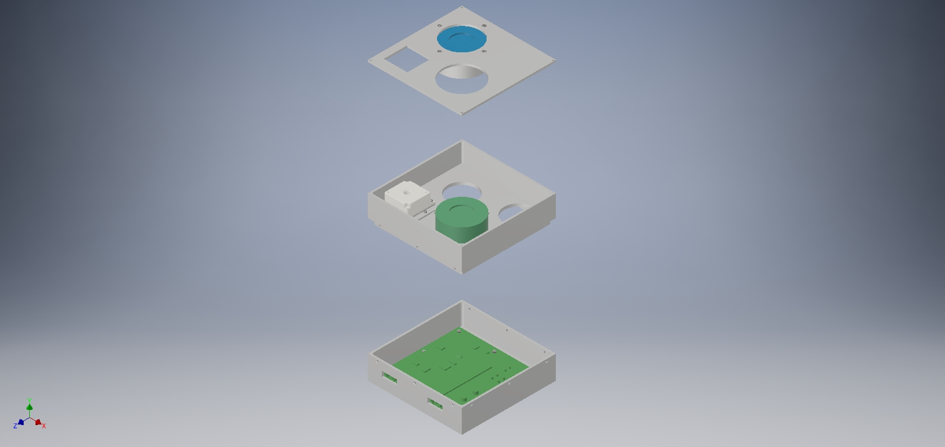
Assembly - Image (exploded)

Slide 48
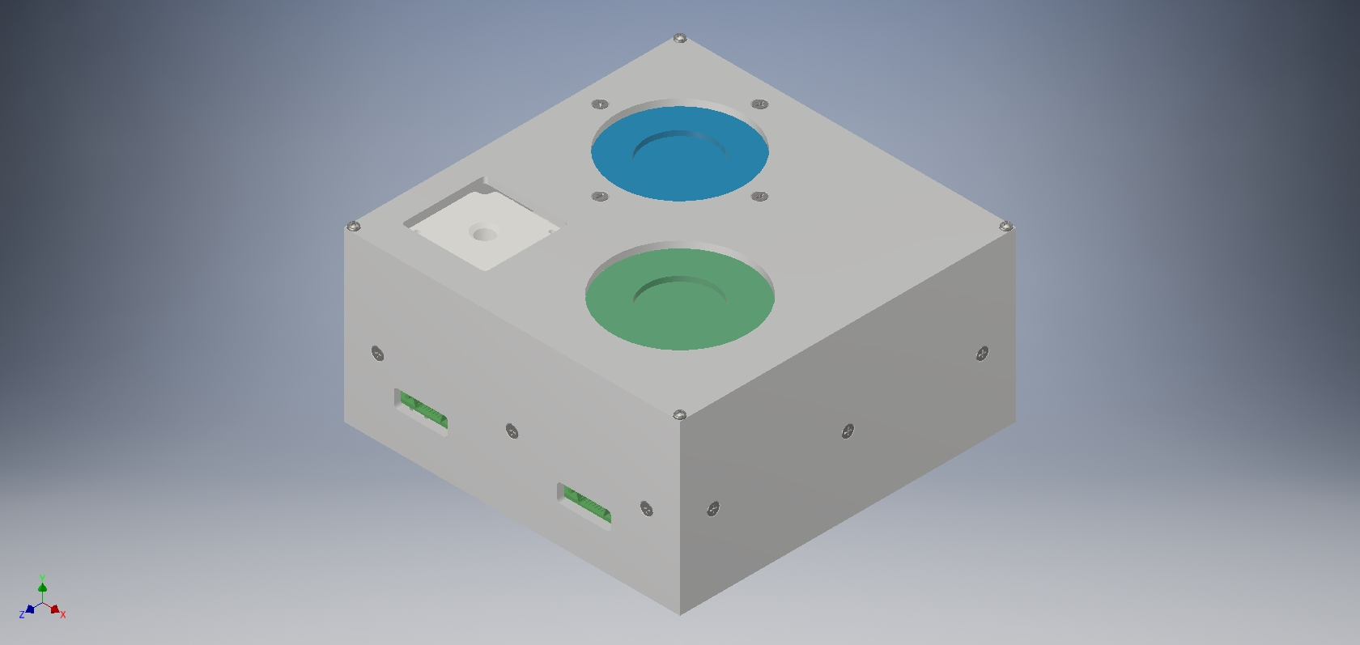
Assembly - image

Slide 49
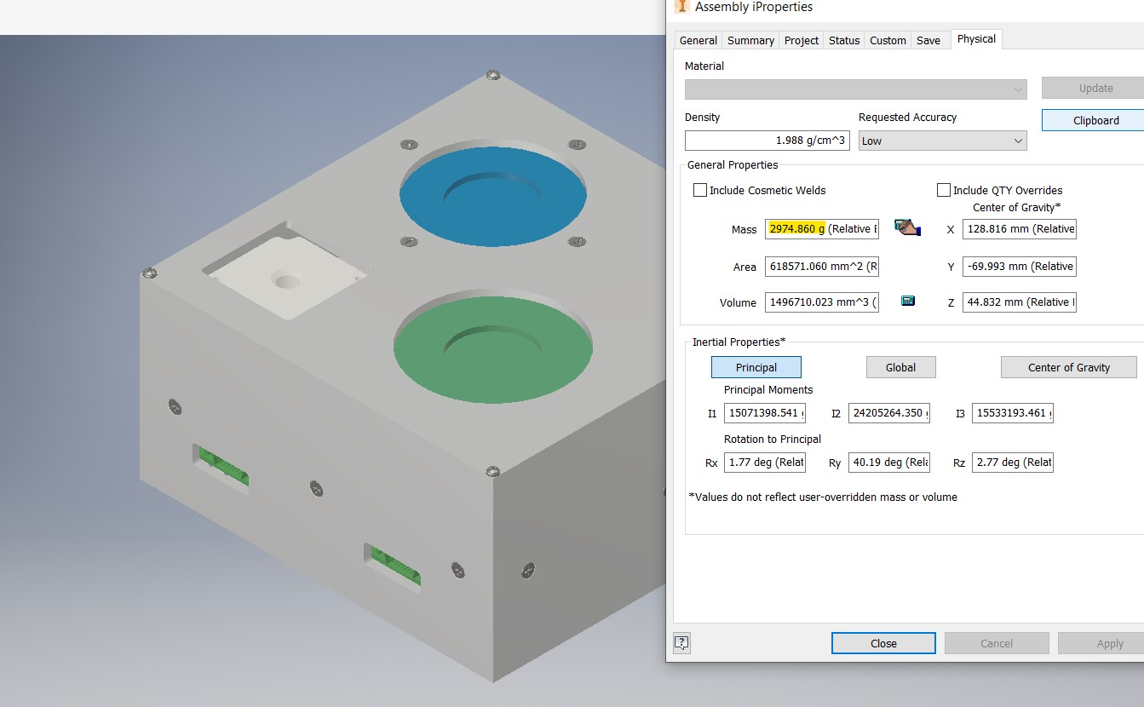
Overall mass
2974.860 g

Slide 50
References
https://www.americanmachinist.com
https://www.sandvik.coromant.com/en-gb/pages/default.aspx
https://www.dekmake.com/guide-to-iso-2768/
https://tarkka.co/
https://www.cnccookbook.com
https://fractory.com/engineering-blog/
https://www.dimensionalconsulting.com/tolerance-of-position.html
https://www.gdandtbasics.com/gdt-symbols/
https://forums.autodesk.com/t5/inventor-forum/bd-p/78

